Slide 1
Lexical Simplification of Hindi Text

Slide 2
What is TS? - done
Need? Trump Vs Biden Speech Readability figure - done
Tharoor’s example - done
Hindi websites – done
Application of TS – image - done
LS Pipeline – Shardlow - done
Sem Eval Tasks
Trend of features – show the graph
Problem with Indian native and non-native speakers – no clear separation of languages, unlike other languages
Average rank assigned
Ablation test, soft voting
RandomSearch, GridSearch
Add your personal social media handle to slides used for your presentation! Attendees will want to share quotes, photos, and follow you.
The content does not reflect the speaker’s opinion; the figures regarding analysis of political speeches have been taken from duly cited sources

Slide 3

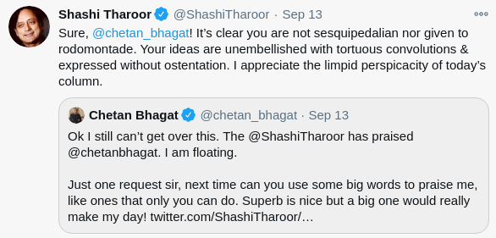
Text Simplification... Why?
Sources: https://twitter.com/shashitharoor/status/1305097520981225472?lang=en; https://twitter.com/shashitharoor/status/861608665517895680?lang=en

Slide 4
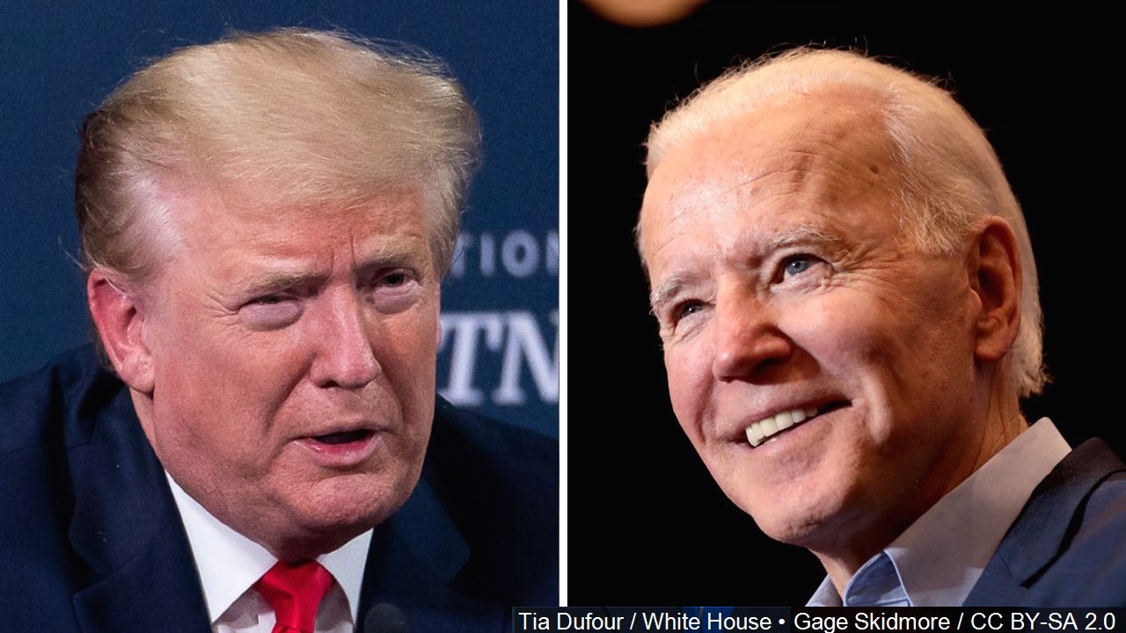
Complexity of Nomination Acceptance Speeches
Flesch Reading Ease
(100% = simple)
60%
72.3%
Length
6944 words
3196 words
Source: https://www.bloombergquint.com/gadfly/biden-and-trump-nomination-speeches-are-two-clashing-word-clouds

Slide 5
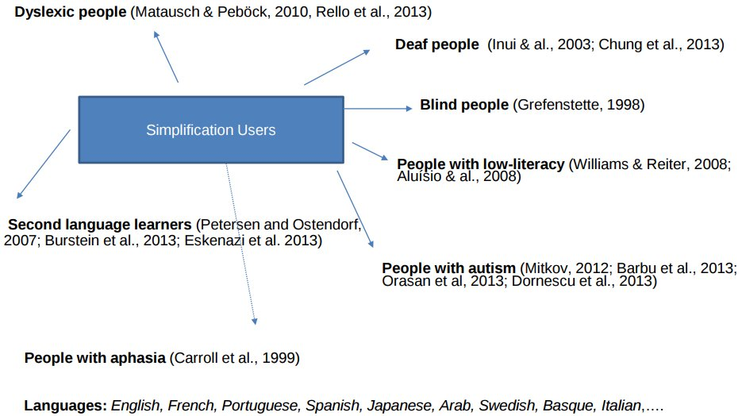
Text Simplification and its Applications
Source: https://zenodo.org/record/2593329#.XIzyaayYW02 presented at the Department of Information and Communication Technologies, Universitat Pompeu Fabra, in the context of the María de Maeztu data-driven knowledge extraction strategic research program (MDM-2015-0502), by Horacio Saggion and Sanja Štajner in 2019.

Slide 6
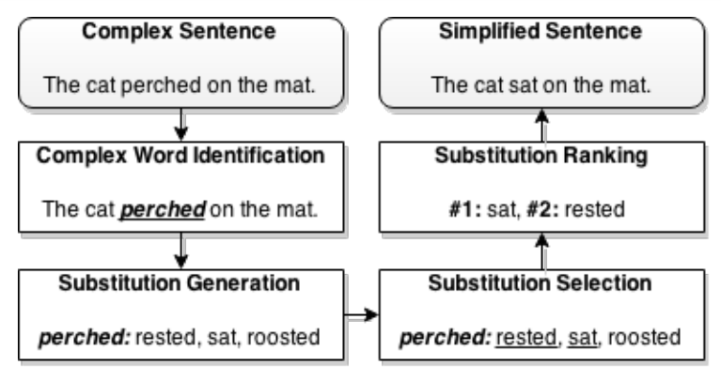
Lexical Simplification Pipeline
Source: Paetzold, G. (2015, June). Reliable lexical simplification for non-native speakers. In Proceedings of the 2015 Conference of the North American Chapter of the Association for Computational Linguistics: Student Research Workshop (pp. 9-16).
Adaptation of the pipeline proposed by Shardlow, M. (2014, May). Out in the Open: Finding and Categorising Errors in the Lexical Simplification Pipeline. In LREC (pp. 1583-1590).

Slide 7
SemEval Shared Tasks on Complex Word Identification (CWI)
Summary of features employed in CWI Shared Tasks 2016
Summary of features employed in CWI Shared Tasks 2018
Sources: Paetzold, G., & Specia, L. (2016, June). Semeval 2016 task 11: Complex word identification. In Proceedings of the 10th International Workshop on Semantic Evaluation (SemEval-2016) (pp. 560-569); Muhie Yimam, S., Biemann, C., Malmasi, S., Paetzold, G. H., Specia, L., Štajner, S., ... & Zampieri, M. (2018). A Report on the Complex Word Identification Shared Task 2018. arXiv, arXiv-1804.

Slide 8
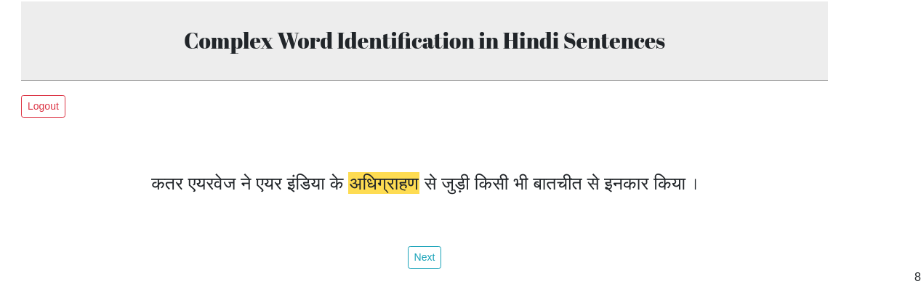
Task 1 - Annotation
Screens designed by Kumar Ashwin (https://krash.dev)

Slide 9
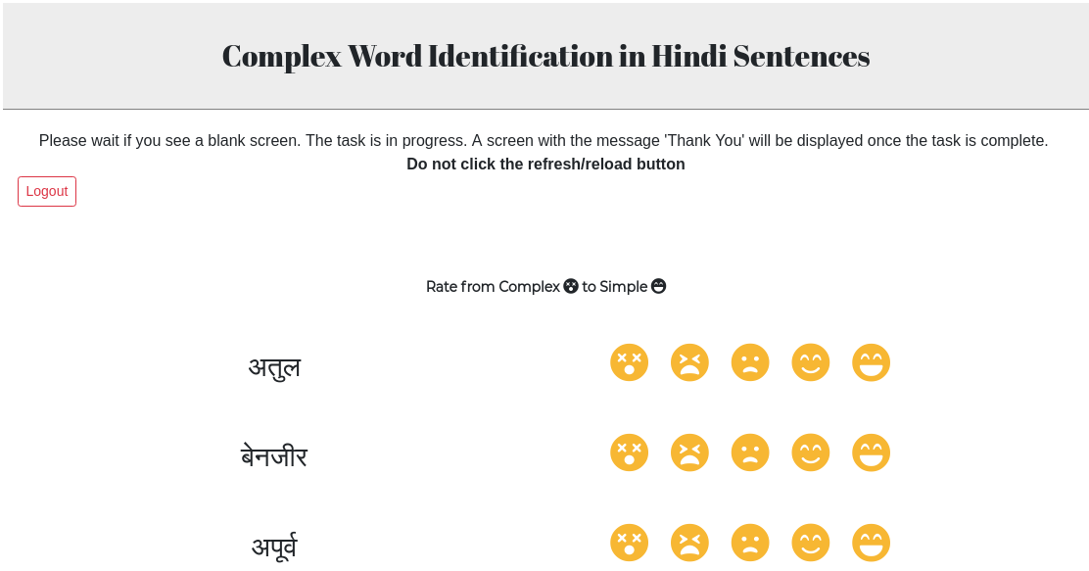
Task 2 - Rating

Slide 10
S.No. | Source | Unique Word Count | Unique Lemma Count | Domain
1 | Language Resource#1 | 145,507 | 117,309 | Aesthetics
2 | Language Resource#2 | 21,335 | 17,159 | Entertainment
3 | Language Resource#3 | 119,313 | 102,201 | Not available
4 | Language Resource#4 | 2,330 | 1,851 | Varied domains
5 | Language Resource#5 | 21,826 | 18,220 | Tourism
6 | Language Resource#6 | 39,351 | 32,074 | Agriculture and Entertainment
7 | Language Resource#7 | 35,018 | 28,645 | Agriculture, Entertainment, Politics and Public, Administration, Sports, Religion, Literature, Aesthetics, Economy
8 | Language Resource#8 | 20,430 | 16,673 | Health
9 | Language Resource#9 | 5,322,602 | 4,579,200 | News

Slide 11
Data Description
Number of words ranked by participants | 68,107
Number of unique words ranked by participants | 18,186
Number of unique words annotated by atleast two participants | 12,111
Number of unique words ranked by atleast two participants and that are present in our corpus | 7,315

Slide 12
Features, Classifiers and Evaluation Metrics
Features | length, number of syllables, frequency of the lemma of the word, number of consonants, number of vowels, number of consonant conjuncts, number of synsets, number of synonyms, number of hypernyms and the number of hyponyms
Classifiers | decision tree, support vector classifier, nearest centroid classifier, random forest, extra trees, ada boost, gradient boosting and XG boost
Evaluation Metrics | AUC Scores
Created a stopword list: https://github.com/gayatrivenugopal/hindi-corpus-stoplemmas
Normalised feature values
We used soft voting classification and random search hyperparameter tuning of the models. Receiver Operating Characteristic (ROC) scores were used to tune the models.

Slide 13
Model | AUC Score
Ada | 0.776
Tuned Ada | 0.781
Extra Trees | 0.760
Tuned Extra Trees | 0.762
Gradient Boosting | 0.783
Tuned Gradient Boosting | 0.755
Random Forest | 0.770
Tuned Random Forest | 0.785
XGBoost | 0.785
Tuned XGBoost | 0.782
Soft Voting | 0.790

Slide 14
Ongoing and Future Work
Analysis of user data
Hyperparameter tuning using Grid Search
Adding fasttext embeddings as a feature for classification
Treating the task as a token classification task – using data from Task 1
Word sense disambiguation
Synonym selection and substitution

Slide 15
Language Resources
Language Resource#1: Aesthetics Corpus
Language Resource#2: The Open Parallel Corpus (n.d.). Retrieved July 12, 2019, from http://opus.nlpl.eu/.
Language Resource#3: CFILT Hindi Corpus (n.d.). Retrieved July 15, 2019, from https://www.cfilt.iitb.ac.in/Downloads.html.
Language Resource#4: Kunchukuttan, A., Mehta, P. & Bhattacharyya, P. (2018). The IIT Bombay English-Hindi Parallel Corpus. Language Resources and
Evaluation Conference.
Language Resource#5: English-Hindi Tourism Text Corpus – EILMT (October, 2016). EILMT Consortia, CDAC Pune. Retrieved July 15, 2019, from
http://www.tdil-dc.in.
Language Resource#6: Hindi-English Agriculture & Entertainment Text Corpus ILCI-II (May, 2017). ILCI Consortium, JNU. Retrieved July 15, 2019, from
http://www.tdil-dc.in.
Language Resource#7: Hindi Monolingual Text Corpus ILCI-II (June, 2017). ILCI-II, JNU. Retrieved July 15, 2019, from http://www.tdil-dc.in.
Language Resource#8: Hindi-English Health Text Corpus-ILCI (April, 2012). ILCI Consortium, JNU. Retrieved July 15, 2019, from http://www.tdil-dc.in
Language Resource#9: Kunchukuttan, A., Kakwani, D., Golla, S., Bhattacharyya, A., Khapra, M. M., & Kumar, P. (2020). AI4Bharat-IndicNLP Corpus:
Monolingual Corpora and Word Embeddings for Indic Languages. arXiv preprint arXiv:2005.00085.

Slide 16

image: Freepik.com

Slide 17
I am excited to be speaking at #WWCode #ConnectForward in December about [speaker topic] and look forward to meeting the @womenwhocode community. 😃 Get tickets → https://hopin.com/events/wwcode-connect-forward
👩🏾‍💻 Join me at #WWCode #ConnectForward in December for technical content made by engineers for engineers. Get your ticket here → https://hopin.com/events/wwcode-connect-forward
I am proud to join a world-class lineup at #WWCode #ConnectForward in December to share our technical knowledge to help you be successful in the #techindustry. Get your tickets →https://hopin.com/events/wwcode-connect-forward
Learn about [speaker topic] at my talk at at #WWCode #ConnectForward on 12/2-12/4. Get tickets → https://hopin.com/events/wwcode-connect-forward
LinkedIn
#WWCode #ConnectForward is a premier technical conference made by engineers for engineers. I am excited to be speaking about [speaker topic] on 12/2-12/4. Get your tickets→ https://hopin.com/events/wwcode-connect-forward
Do you want to learn more about {speaker topic]? Attend my talk at #WWCode #ConnectForward in December - who’s joining me for one of the most incredible days on the tech calendar? Get your tickets → https://hopin.com/events/wwcode-connect-forward

